Slide 1
Logistic Regression
Itay Hazan

Slide 2










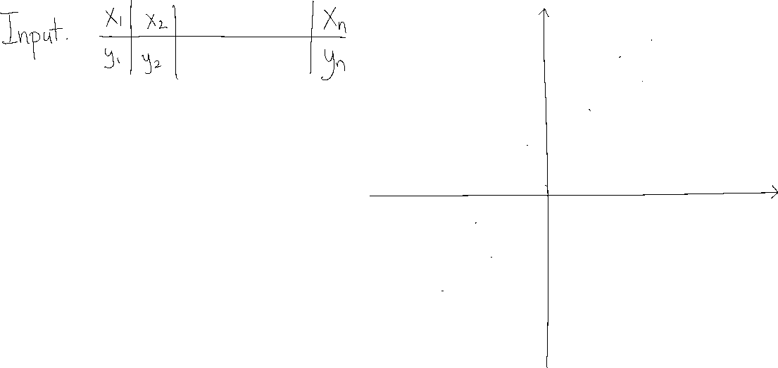









Reminder: Linear Regression

Slide 3

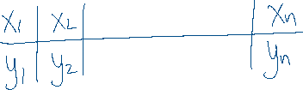


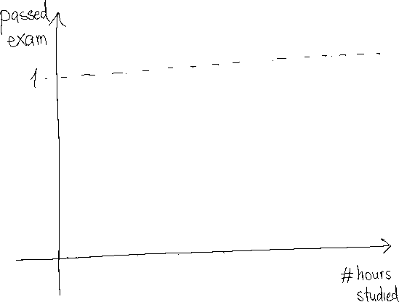
Binary Logistic Regression

Slide 4











Binary Logistic Regression

Slide 5


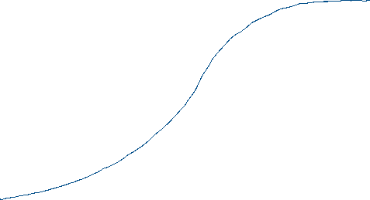




Binary Logistic Regression

Slide 6
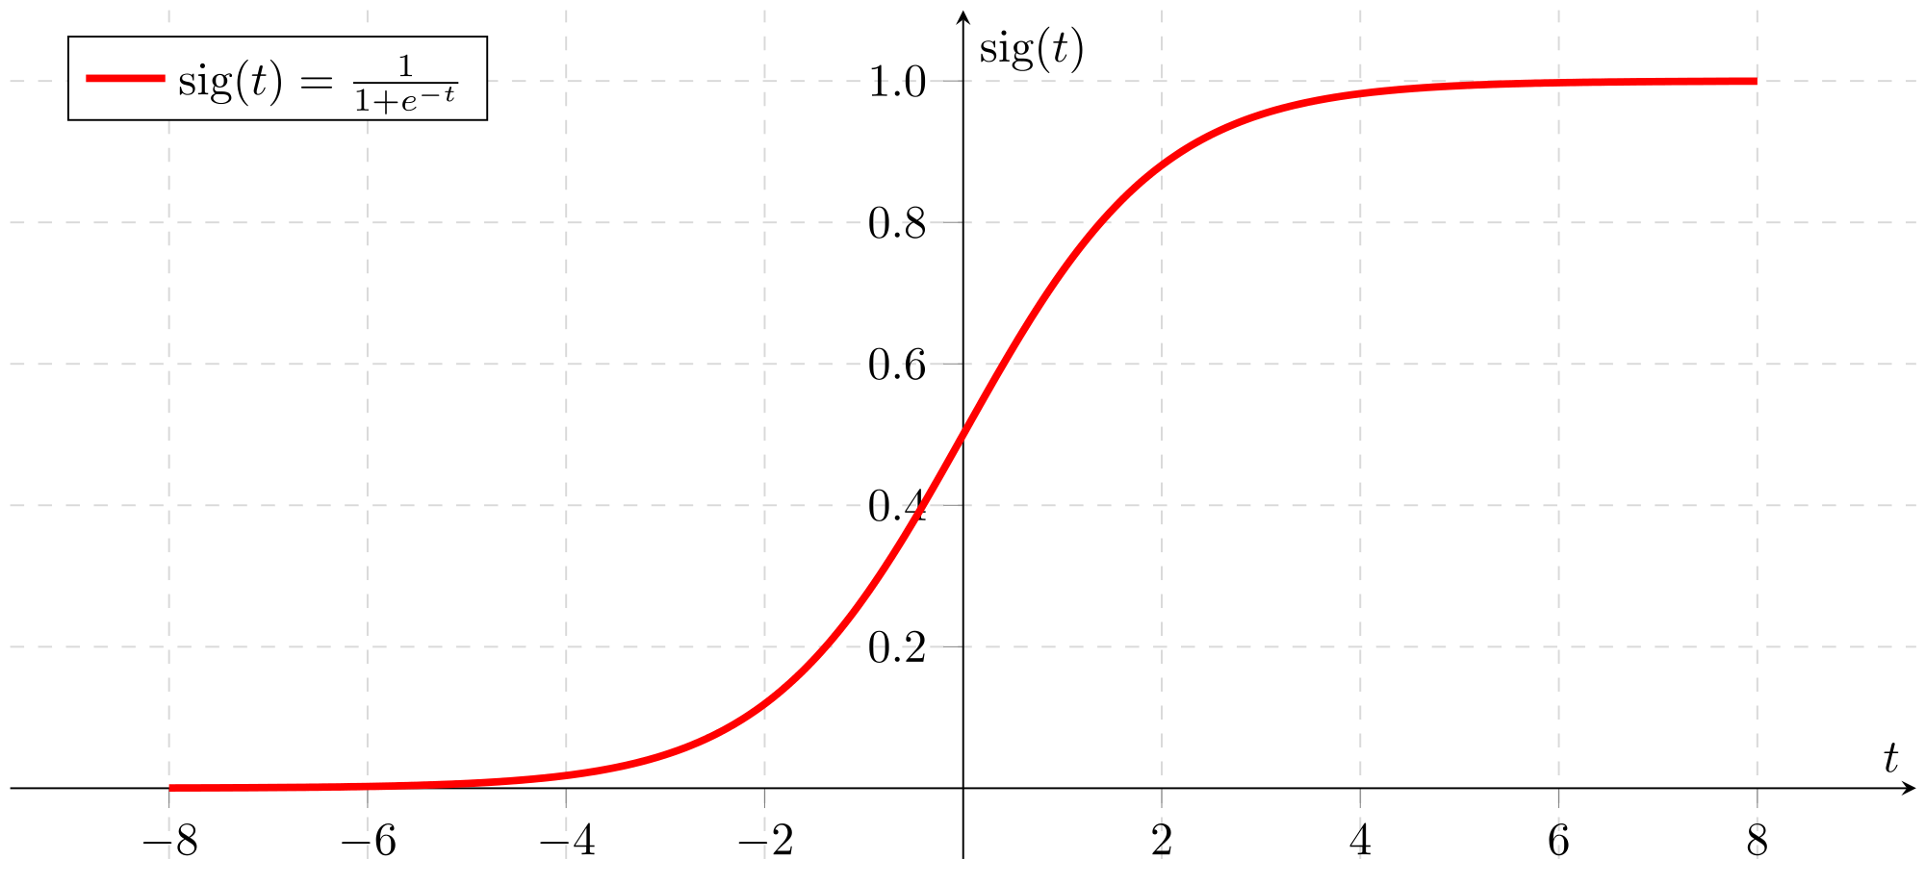





Binary Logistic Regression

Slide 7

















Binary Logistic Regression

Slide 8




Binary Logistic Regression

Slide 9









Binary Logistic Regression

Slide 10



Binary Logistic Regression

Slide 11




Binary Logistic Regression

Slide 12








Binary Logistic Regression

Slide 13







Binary Logistic Regression

Slide 14






Binary Logistic Regression

Slide 15






Binary Logistic Regression

Slide 16












Binary Logistic Regression

Slide 17
Multivariate Binary Logistic Regression

Slide 18













Multivariate Binary Logistic Regression

Slide 19


Multivariate Binary Logistic Regression

Slide 20
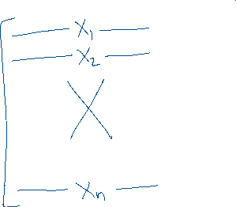





Multivariate Binary Logistic Regression

Slide 21





Multivariate Binary Logistic Regression

Slide 22


Multivariate Binary Logistic Regression

Slide 23
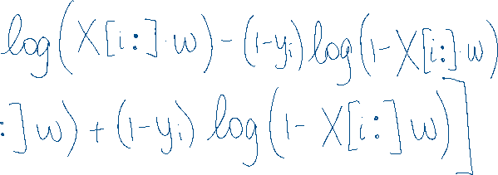



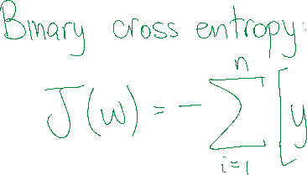
Multivariate Binary Logistic Regression

Slide 24









Multivariate Binary Logistic Regression

Slide 25










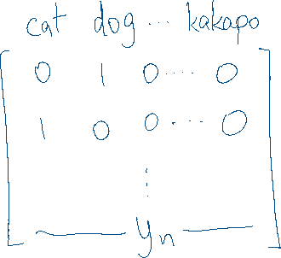







Multivariate Categorical Logistic Regression

Slide 26



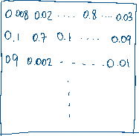

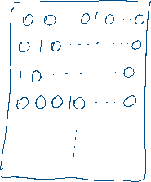
Multivariate Categorical Logistic Regression

Slide 27
Multivariate Categorical Logistic Regression

Slide 28
Multivariate Categorical Logistic Regression

Slide 29





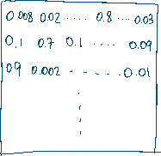

Multivariate Categorical Logistic Regression

Slide 30








Multivariate Categorical Logistic Regression

Slide 31

Multivariate Categorical Logistic Regression

Slide 32

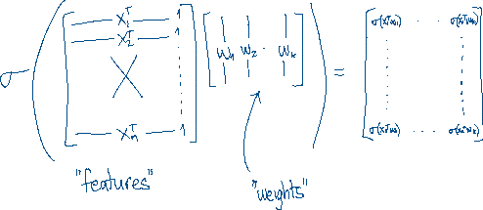

Multivariate Categorical Logistic Regression

Slide 33
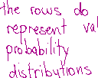

Multivariate Categorical Logistic Regression

Slide 34
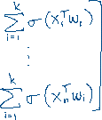

Multivariate Categorical Logistic Regression

Slide 35
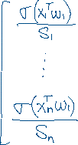

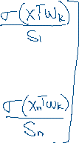

Multivariate Categorical Logistic Regression

